Slide 1
Capital Gain or Loss
Form 1040 – Line 13
Pub 4012 – Tab D
Pub 4491 – Part 3 – Lesson 11
Notes:
1
Significant Slide Updates to Release 2:
60, 67, 68 Revised: Summarize Multiple Broker Transactions
Revised: Use Site Procedures if submitting Form 8453
63,64,65,66 Updated TaxSlayer screen shots
Revised: Adjustment Codes in TaxSlayer
Reworded: Special Situation 3rd bullet point
97 Reworded: Tax Calculation
102 Revised: Main Home Basic Quiz
Added note to Sale of Main Home
118 Revised Sale of Main Home Input
Revised Quality Review Capital Gains and Losses
Instructors are urged to gauge the experience of the audience
Some may be well versed in capital gains and losses; others not at all
LCs are encouraged to gauge the complexity of Taxpayers’ capital transactions
Generally, “simple” transactions are in scope
Assign returns with capital transactions to experienced counselors
If transactions are complicated or are out of scope, refer to a paid preparer
Pub 550 provides information for investment income and the disposition of investment assets

Slide 2

Introduction
What is a capital gain?
  It’s the taxpayer’s profit when they sell a capital asset for more than they have in it
What is a capital loss?
  It’s the taxpayer’s loss when you sell a capital asset for less than they have in it
Notes:
Emphasize why capital gains and losses are important
The lower tax rates apply to those in the lower regular tax brackets
We usually see the 0% or 15% rates

Slide 3
Introduction
Ordinary income tax rates range from 10% to 39.6%
Capital gain tax rates are much lower
  Usually 0% or 15% rate
  Could be 20% rate for very high incomes
Notes:
Emphasize why capital gains and losses are important
The lower tax rates apply to those in the lower regular tax brackets
We usually see the 0% or 15% rates
If anyone asks, the net investment income tax (NIIT) was new in 2014. It adds Medicare taxes (3.8%) on investment income for very high income taxpayers (over $250,000 MFJ)

Slide 4
Capital Asset Taxation
Capital gain tax rates apply to “net long-term gains” and qualified dividends
Ordinary income rates apply to “net short-term gains”
These terms will be explained later

Slide 5
Capital Asset Taxation
Capital gains or losses come from the sale* of capital assets for in-scope returns
*or other reportable event or transaction

Slide 6
What is a Capital Asset
Generally, nonbusiness assets
Securities are capital assets
  Stocks
  Mutual fund shares
  Bonds
There are other capital assets
Notes:
Some participants may not know these terms:
Stocks represent an ownership interest in a corporation
Corporations pay dividends to the stock holders
Mutual fund shares represent an ownership interest in a fund, which itself holds stocks or other securities
Mutual funds pass through the dividends or net gains that they realize to their fund share holders
Net losses are not passed out to the fund share holders, they are kept by the fund and used to offset future gains
Bonds represent a debt owed by a corporation, government or other entity
Typically, bonds have a fixed date on which they are to be paid, called the maturity date
Typically, bond issuers pay interest to the bond holder quarterly, semi-annually, or annually that is reported on F 1099-INT

Slide 7
What is NOT a Capital Asset
Inventory is not a capital asset
Assets used in a business are not capital assets
  Used as a rental
  Used in a business
Copyright, a literary, musical, or artistic composition, letter, memo or similar* are not capital assets
* Held by the creator or letter recipient
Notes:
Sales of these assets are out of scope … see Pub 544 Chapter 2 for further definition of Capital Assets and Noncapital Assets

Slide 8

“Sort-of” Capital Assets
Homes and other non-investment assets
  Capital assets for gains
  Personal assets for losses
    (not deductible)
Government is a profits-only partner!
Notes:
A home includes any property used as a residence
Second home
House boat
Mobile home
See Pub 544 Chapter 2, Capital Assets Defined for detail of IRS treatment.

Slide 9
Types of Assets Quiz
Is this a capital asset?
  IBM stock
  IBM bond
  Vacation home
  Rental property
  Pleasure boat
  Gold jewelry
Yes
Yes
Yes for gains
No
Yes for gains
Yes for gains
Notes:
Gold or other bullion would be considered a “collectible”
Gold jewelry that is worn would not be a collectible
Long-term gains on collectibles are taxed at 28% and are out of scope

Slide 10
When is a Transaction Reported
When asset is sold
When asset is otherwise disposed, such as
  When bond is redeemed
  When it is totally worthless

Slide 11
When Transaction Is Not Reported
Not reported if not a “sale or exchange”
  A gift is not sale or exchange
  Donation to charity is not sale or exchange
  Bequest to heir is not sale or exchange

Slide 12
When is a Transaction Reported
Exception for certain stock-for-stock transactions
  Mergers, spin-offs, split-ups, etc.
  Payer will advise shareholders and report only that which must be reported

Slide 13
Introduction – Sale Of Assets
Key elements of a sale:
  When did you buy it
  When did you sell it
  What is the cost basis
  What is the sales price
Notes:
Introduction phase
More details to follow

Slide 14
IRS Reporting Requirement
Schedule D - Capital Gains and Losses
Form 8949 - Sales and other Dispositions of Capital Assets
TaxSlayer fills in appropriate forms

Slide 15

The Interview
Question 9 in Income section
Question 3 in Life Events section
Notes:
Encourage counselors to ask probing questions
It is not “prying,” it is essential to an accurate return

Slide 16
Interview – What Kind of Sales?
Brokerage or mutual fund statement or Form 1099-B
  Stocks, mutual funds, or bonds (limited)
Sale of a personal residence (discussed in more detail later)
  Sales paid with virtual currencies (e.g. bitcoins) are out of scope
  All other sales are out of scope
Notes:
Caution
Some taxpayers trade stock options or futures
The taxation of these may differ depending on the other transactions that the taxpayer enters into
Taxpayers with stock option or futures trades should be referred to a paid preparer
Some mutual funds or ETFs (exchange-traded funds) are structured as flow-through entities
Often, they issue a K-1 or a summary statement that will have more than what is in scope
Computing basis in these securities can be very complex and most are not yet “covered securities”
Taxpayers with complex K-1s should be referred to a paid preparer

Slide 17
Interview – Brokerage or Mutual Fund Statement
Review forms with taxpayer
Confirm that cost is reported on forms
  Does taxpayer agree with reported cost?
  If not, does taxpayer have cost?
Only stocks, mutual funds or some bonds
Many transactions? (use short-cut discussed later)
Notes:
Emphasize
Taxpayers who day trade or trade in futures and options should be referred to a paid preparer
Taxpayers with municipal bonds may have complicated premium or discount amortizations
If not fully reported by the brokerage, refer to paid preparer
Example: muni bond purchased directly at a premium
Premium would need to be amortized
If sold or redeemed before maturity, the unamortized premium is part of the cost basis
LC will guide if too many transactions
May not need to type all into the form
Will show short-cut later

Slide 18
Interview – Forms 1099-B
Forms 1099-B (not on brokerage or mutual fund statement)
  Review forms with taxpayer
  Confirm that cost is reported on forms
    Does taxpayer agree with reported cost?
    If not, does taxpayer have cost?
  Only stocks, mutual funds or some bonds
Notes:
Many taxpayers don’t use a brokerage and hold shares in corporations directly
They may also buy Treasury or other bonds directly
Both require the taxpayer to keep records of their basis

Slide 19
AARP Tax-Aide Scope
Form 8949 is In Scope for:
  Sale of stocks, mutual fund shares and personal residences
  Sale of bonds that mature or are sold with no gain or loss
  Bond sales reported on a brokerage statement with capital gain or loss only (no ordinary income/loss)
  … Continue
Notes:
TaxSlayer input Federal Section > Income > Capital Gain and Losses (Schedule D)
NTTC Scope Manual: Schedule D – is in scope. Column 4 limitations refer Capital Gains and Losses => See F 8949 limitations

Slide 20
AARP Tax-Aide Scope page 2
  Capital gains and losses reported on Schedule K-1
  Capital loss carryovers
  Inherited property if listed above and, if inherited in 2010, taxpayer provides the acquisition date and basis
  … Continue

Slide 21
AARP Tax-Aide Scope page 3
  Gifted property if listed above and taxpayer provides the acquisition date and basis, which can differ depending on whether disposition is at a gain or loss
  Worthless securities if reported on brokerage statement
  Wash sales if reported on brokerage or mutual fund statement

Slide 22
AARP Tax-Aide Out of Scope
Adjustments:
  Nominee income
  Qualified small business stock
  DC zone assets
  Rollover of gain
  Small business loss
  Collectibles
Reduced exclusion on sale of home
Notes:
See Publication 4012 D-39

Slide 23
Accounting for Bonds
Generally, a premium paid on purchase would be amortized as reduction of interest income during years owned
Generally, discount on purchase would be amortized as additional interest income during years owned
The rules are very complex and depend on type of security, date issued, etc.
Computation of amortization is out of scope
Notes:
Many brokers or payers will do the computation of amortization

Slide 24
Disposition of Bonds
Limited scope applies to bonds
In scope if original purchase was at face value (no discount or premium)
  Gain or loss if sold will be capital gain or loss
  If held to maturity, there would be no gain or loss (cost = face value)

Slide 25
Disposition of Bonds
Limited scope applies to bonds
If purchased at discount or with a premium, accounting for discount or premium must have already been done
  Either by payer (broker), or
  By taxpayer

Slide 26
Disposition of Bonds
Limited scope applies to bonds, examples of in-scope transactions
  Treasury bond/note held to maturity – result would be zero gain or loss
  Municipal bond held to maturity – result would be zero gain or loss
  Any bond purchased at face value – result (if any) would be capital gain or loss
Notes:
For both Treasury or Municipal bonds,
Discount should have been amortized as additional interest income
Broker should report cost equal to the face value
Premium should have been amortized as a reduction to interest income
Broker should report cost equal to the face value
Bonds acquired by other than purchase, such as inheritance or gift
May be subject to amortization
Generally, out of scope

Slide 27
What is the Basis* of Shares
Cost – amount originally paid
Adjustments to basis* (of shares)
  Purchase expenses (commissions)
  Sale expenses, if not already used to reduce proceeds
  Non-dividend distributions
Broker’s requirement to report basis
  (“covered” shares discussed later)
* Basis is term generically used for cost or adjusted basis
Notes:
27
Cost and Cost Basis mean the same thing
Bonds and the adjustment to basis for amortization of premium or discount is beyond the scope of this discussion
If there is any amortization required for a bond, the payer or the taxpayer must
Compute the amortization
Determine the proper basis upon disposition
Covered security: This category was created in Section 403 of the Energy Improvement and Extension Act of 2008 (Public Law 110-343, division B). In US tax law, a covered security is one which, on sale, the broker must report to the IRS the customer's basis and whether the sale is short-term or long-term. This applies to certain types of securities, acquired after a specified effective date – the law phases in between January 1, 2011 and January 1, 2013 (or later).

Slide 28
What is the Basis
What if don’t know basis?
  Taxpayer could estimate basis if know when it was acquired
    But need to have something
    Watch out for intervening splits, mergers, etc.
  IRS rule: report zero as basis if taxpayer doesn’t have any information
Notes:
28
Cost and Cost Basis mean the same thing

Slide 29
What is the Basis
What if there are multiple buys?
  For shares, each buy is called a “lot”
  Normally track basis by unit or by “lot”
  Example:
    1st lot: Buy 100 shares of IBM 1/1/2001
    2nd lot: Buy 200 more shares of IBM 7/1/2001
Notes:
29
Cost and Cost Basis mean the same thing

Slide 30
What is the Basis
For all shares
  Which lot (or part of a lot) was sold?
    First-in first-out method (default method)
    Specific identification method (taxpayer picks which shares were sold at the time of sale)
  Important if shares bought at different times had different prices
    May affect long or short status
Notes:
30
First-in first-out: – the earliest purchased shares are treated as being sold first, until that lot is depleted; then use the next earliest purchase
For covered securities, described later, brokerages will follow instructions from the account holder on the method they want to use for multiple lots

Slide 31
What is the Basis
For mutual fund shares – a third choice
  First-in first-out method
  Specific identification method
  Average cost method (default used)
  Includes ETFs (exchange traded funds)
Notes:
31
Also includes REITs – Real Estate Investment Trusts
Brokerages and mutual funds use the average cost method as a default for mutual fund and ETF shares
Average cost method
There are variation on the arithmetic, but generally
Total cost of multiple purchases (lots) e.g. $400 + $500 + $600 = $1,500
Divided by total number of shares purchased, e.g. 40 +45 + 50 = 135
Equals average cost per share, e.g. $1,500/135 = $11.11 per share

Slide 32
Special Situation
Stock dividends or stock splits
  Shareholder receives additional shares, usually no additional cost
  Basis of old shares is spread over all shares (old and new)
  Date acquired for new shares is same as for old shares

Slide 33
Stock Dividend or Stock Split Example
Bought 100 shares for $5,000 on 7/1/2006
  $50 per share ($5,000 ÷ 100 shares)
On 3/1/2014, receives 100 more shares due to stock split
Total basis is still $5,000
  Now $25 per share ($5,000 ÷ 200 shares)
Date acquired for all 200 shares is 7/1/2006

Slide 34
Stock Dividend or Stock Split
Sometimes, the number of new shares is fractional, e.g. 4.2 shares
Payer may issue fractional shares, or
Payer may “cash out” fractional shares
  It’s a sale of fractional share that shareholder would have received
  Reported on 1099-B
Basis of old shares is spread over all shares, including fractional share
Notes:
Fractional shares are often seen with mutual funds or corporations that have DRIPs (Dividend Reinvestment Plans)

Slide 35
Stock Dividend or Stock Split
Fractional share example
Basis of 100 old shares: $1,000 ($10.00 per share)
Stock dividend of 4.2%
Basis of all shares is still $1,000 but is now $9.60 per share ($1,000 ÷ 104.2 shares)
Basis of 0.2 share is $1.92 (0.2 x $9.60)

Slide 36
Capital Gains Quiz
Taxpayer who paid $1,000 for 100 shares of XYZ stock received a 2 for 1 stock split
What is his adjusted basis per share in XYZ?
  $5 per share

Slide 37
What is the Basis – Gifts
Property received as gift
  Must know basis in the hands of donor
  Must know fair market value on day of gift
Which to use?
Depends on which is higher and whether computing gain or loss
Taxpayer needs to provide basis or be referred to paid preparer
Notes:
37
Special rules for gifts received before 1977
See Pub 550 if want more details on property received as a gift

Slide 38
What is the Basis – Inherited
Inherited Property
  From decedent who died before or after 2010
    Fair Market Value (FMV)
      On date of death -OR-
      On alternate valuation date, if elected by estate
    Taxpayer needs to provide basis or
    be referred to paid preparer
  Always long term
  Use “Inherited – Long Term” in TaxSlayer, Date
  Acquired dropdown selection
Notes:
The executor can choose to value the estate’s assets at the date of death or the alternate valuation date
The Alternate valuation date is the date six months after the date of death
If no estate tax return was filed, basis is fair market value on the date of death
Special rules may apply to community property
Surviving spouse may step up the basis of the whole property to fair market value, not just the decedent’s half

Slide 39
What is the Basis – Inherited
Inherited Property
  From decedent who died in 2010
    Usually fair market value on date of death (Inherited – Long Term)
    Special election by estate
      In-scope if basis provided on Form 8939 (received from estate)
      Purchase date is same as decedent’s purchase date (shown on Form 8939)
Notes:
If no estate tax return was filed, basis is fair market value on the date of death
INHERIT property is long term

Slide 40
What is the Basis – Inherited
Community property states (usually)
  Basis of 100% of the property is based on the date-of-death value
  Follow rules for your state.
Separate property states (usually)
  Basis of the decedent’s interest is based on the date-of-death value
  Basis of survivor’s interest unchanged
Notes:
Instructors can specify the rules for their state
It is still the taxpayer’s responsibility to know their basis

Slide 41
Holding Period
When did you buy it? When did you sell it?
Always use “trade date” for securities
  Settlement date will be later
Difference between buy date and sell date is the “holding period”
Notes:
Trade date is the date the buy or sell order is executed
Stocks trade throughout the day the particular stock exchange is open, including after-hour markets
Mutual funds trade at the closing price of the day
Settlement date
Stock – is usually 3 business days after the trade date
Mutual funds – can be the next day or several days later

Slide 42
Holding Period – Capital Assets
Long term = more than one year
Short term = one year or less
Notes:
Property inherited in 2010 (decedent died in 2010)
Estate could have made a special elected
Result is that estate must give the beneficiary Form 8939 with that special election basis
If estate did not make the special election or there was no estate tax return file
Use fair market value on the date of death

Slide 43
Holding Period Quiz
Buy 6/1/15 sell 6/1/16 short or long term?
  Short term (1 year)
Buy 6/1/15 sell 6/2/16 short or long term?
  Long term (1 year + 1 day)
Buy 6/2/13 sell 6/1/12 (short sale) short or long?
  Short sales are usually short term (would need to hold shares for > 1 year before using to cover short position)
Notes:
A short sale is: A market transaction in which an investor sells borrowed securities in anticipation of a price decline and is required to return an equal number of shares at some point in the future.
Example: Suppose 1,000 shares are short sold by an investor at $25 apiece and $25,000 is then put into that investor's account. Let's say the shares fall to $20 and the investor closes out the position. To close out the position, the investor will need to purchase 1,000 shares at $20 each ($20,000). The investor captures the difference between the amount that he or she receives from the short sale and the amount that was paid to close the position, or $5,000.

Slide 44

Holding Period Of Capital Assets
Good news: TaxSlayer does date arithmetic!
In TaxSlayer be sure to carefully enter dates

Slide 45
What is the Sales Price?
Gross proceeds (sales price)
  Not reduced for expenses of sale
Net proceeds
  Already reduced for expenses of sale
1099-B specifies method used
Notes:
Emphasize
With better reporting by brokers and more taxpayers using brokers, less adjustments are needed to basis
If Taxpayer is trading stock options or futures, they should be referred to a paid prepare

Slide 46
Gross or Net Proceeds
If gross proceeds are reported on 1099-B
  Do not adjust proceeds for expenses of sale
  Instead, make adjustment equal to selling expenses (noncovered only)
IRS matches proceeds reported on all Forms 1099-Bs to total proceeds on tax return
Don’t adjust for covered securities – broker has already reflected in basis
Notes:
Emphasize
IRS matches total proceeds reported on Forms 1099-B, so do not adjust proceeds

Slide 47
Capital Gains Quiz
Taxpayer bought 100 shares of XYZ stock for $500 and sells them receiving $7 per share minus total commission of $15
What is sales price (reduced for commissions, “net proceeds”) on 1099-B?
$685
What is cost to be reported for shares sold?
$500
Notes:
Note that gain is $185. This follows IRS directions that brokers are required to deduct commissions and transfer taxes from proceeds.

Slide 48
Capital Gains Quiz
Taxpayer bought 100 shares of XYZ stock for $500 and sells them receiving $7 per share minus total commission of $15
What is sales price (not reduced for commissions, “gross proceeds”) on 1099-B?
$700
What is cost to be reported for shares sold if payer did not reflect commission in “Sales Price”?
$500 with a -$15 adjustment (explanation > “Form 1099-B with Basis in Box 3 is incorrect”)
Notes:
Note that gain is still $185. For example if Substitute Form 1099-B has Code E (noncovered transaction) then taxpayer should report the reported sales price and adjust selling expenses or option premiums.

Slide 49
Entering in TaxSlayer
Taxpayer receives substitute Form
1099-B or IRS supplied Form 1099-B
There may be “corrected” forms – use last one received (will have date)
Follow the statement
  Unless taxpayer has information that statement is incorrect or incomplete

Slide 50
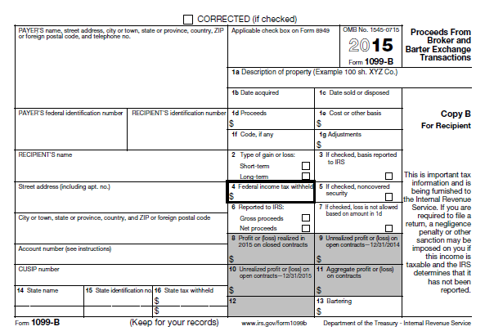
2016
Actual form
Many brokers provide a
“substitute” 1099-B
Notes:
Brokers and mutual funds use their own substitute formats that contain the same information … hopefully the box numbers are the same.
Out of scope:
Bartering transactions
Certain contract transactions

Slide 51
IRS Instructions for Form 1099-B
Defines generally:
  Covered securities are shares purchased after 12/31/2011 and cost basis will be reported to shareholder and the IRS.
  Noncovered securities are shares that are not covered. Generally purchased before 1/1/2012 and cost basis will not be reported to the IRS (Form 8949 Code E).
Notes:
Form 1099B. If the property you sold was a covered security, its basis should be shown in box 1e of the Form 1099-B (or substitute statement) you received from your broker. Generally, a covered security is any of the following.
Stock you acquired after 2010 (generally after 2011 if in a mutual fund or other regulated investment company, or acquired through a dividend reinvestment plan).
Certain stock held in a mutual fund or in connection with a dividend reinvestment plan for which a single-account election is in effect.
Certain debt instruments you acquired after 2013.
Certain options, warrants, and stock rights you granted or acquired after 2013.
A securities future contract you entered into after 2013.
For more information, see section 6045(g) and Regulations section 1.6045-1.
Cost basis for noncovered securities purchased before 1/1/2012 may or may not be reported to shareholders on substitute Form 1099-B.

Slide 52
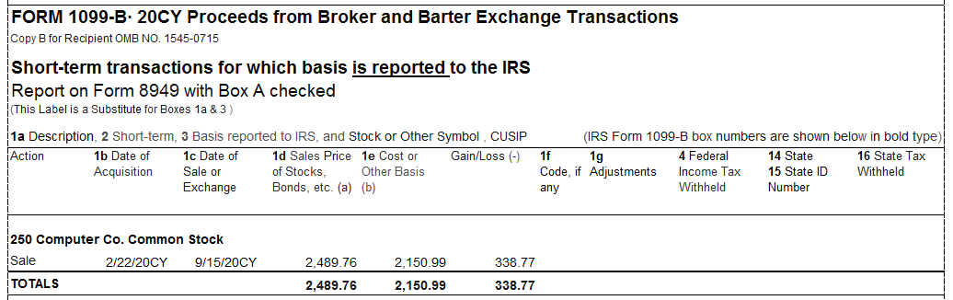
Sample Brokerage 1099-B
Format varies by brokerage firm
Brokers may present transactions subtotaled based on “1099” code
Notes:
Read form carefully – it will say what type of transaction it is

Slide 53
Reporting Sales of Securities
The “payer” prepares the report
  Brokerage
  Mutual Fund
  Corporation’s transfer agent (for shares held directly, not in brokerage)
  Clearing house
Uses Form 1099-B or substitute

Slide 54
1099-B Requirements –
All Transactions
Payer must report:
  Proceeds (gross or net)
  Date of transaction
  Description and quantity of securities sold
May need to report more information

Slide 55
1099-B Requirements –
Covered Transactions
Only if securities sold were “covered securities” (transaction was required to be reported to IRS)
Payer must also report:
  Cost or other basis
  Whether gain or loss is short-term or long-term
  A code and adjustment amount, e.g. W for wash sale and amount of loss to disallow
Not required for noncovered securities
Notes:
Wash sales discussed later

Slide 56
Covered/Noncovered Securities
Multi-year phase in of reporting rules required for covered securities
Started in 2011 with reporting of basis for stocks purchased after 2010
Have added mutual fund shares and some bonds
Will continue with certain other securities in 2016 and beyond

Slide 57
Covered/Noncovered Securities
Payers don’t have to report basis to IRS if security was purchased before applicable start date … noncovered security
Payers can voluntarily report basis to taxpayer even though they do not report it to IRS … noncovered, Form 8949 Code E
Taxpayers/preparers don’t decide what is covered or noncovered – payer does
Notes:
If participants want more information on the phasing, or covered vs noncovered, refer to Pub 550 Investment Income, Glossary or from the payers instructions for the Form 1099-B … http://www.irs.gov/pub/irs-pdf/i1099b.pdf

Slide 58
Covered/Noncovered Securities
Covered – basis reported wrong
  Enter adjustment and select appropriate description from the drop down list
Noncovered – taxpayer supplies the basis (do not use adjustment columns)
Covered or noncovered – proceeds wrong
  Enter adjustment and select appropriate description from the drop down list
Notes:
If participants want more information on the phasing, or covered vs noncovered, refer to Pub 550 Investment Income or Instructions to Form 1099-B … http://www.irs.gov/pub/irs-pdf/i1099b.pdf

Slide 59
Summarize Broker Transactions per Pub 4012 Tab D
Divide the transactions:
Short term Basis reported to the IRS “Box A” | Long term Basis reported to the IRS “Box D”
Short term Basis not reported to the IRS “Box B” | Long term Basis not reported to the IRS “Box E”
Notes:
See Publication 4012, D-38

Slide 60
Summarize Broker Transactions per Pub 4012 Tab D
TaxSlayer > Capital Gains/Loss Worksheet: Input the reported summarized sales price and adjusted cost basis
Find “adjustment explanation”
  Select: “Reporting Multiple Transactions on a Single Row”
Notes:
See Publication 4012, D-37

Slide 61
Taxpayer Reporting 1099-B Cost Basis to IRS
Local sites may elect to NOT send Form 8949 via Form 8453 to Austin
  Tell taxpayer to retain their filing records
  Advise which broker-provided or taxpayer-created pages to submit if the IRS has questions.
Sites with scanning capability should attach pdfs of the required pages to the return before e-filling.
Paper filed returns should include documents showing transaction detail not provided by the broker to IRS (Boxes B and E).
See Pub 4012 with NTTC Changes, page K-22
Notes:
See Publication 4012 with NTTC Changes, K-22.
Note: do not send any documents to the local IRS SPEC Relationship Manager.

Slide 62

TaxSlayer Data Flow
Enter transaction details on
TaxSlayer Schedule D Capital Gains Input
Flows to Forms 8949
Flows to Schedule D
Flows to Form 1040 Line 13
TaxSlayer does the flowing
Notes:
TaxSlayer navigation: Try the form search box or Federal Section > Income >Enter Myself

Slide 63
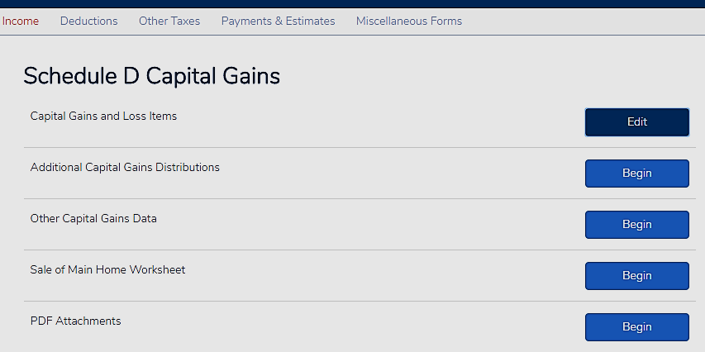
Capital Gains in TaxSlayer
Click to add or edit transaction
Notes:
See Pub 4012 – Section D for screen shots and explanations of TaxSlayer input

Slide 64
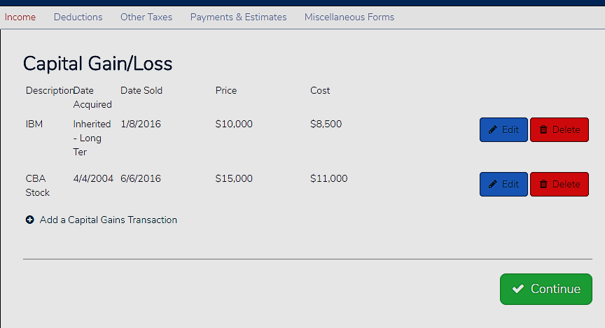
TaxSlayer – Capital Gain

Slide 65
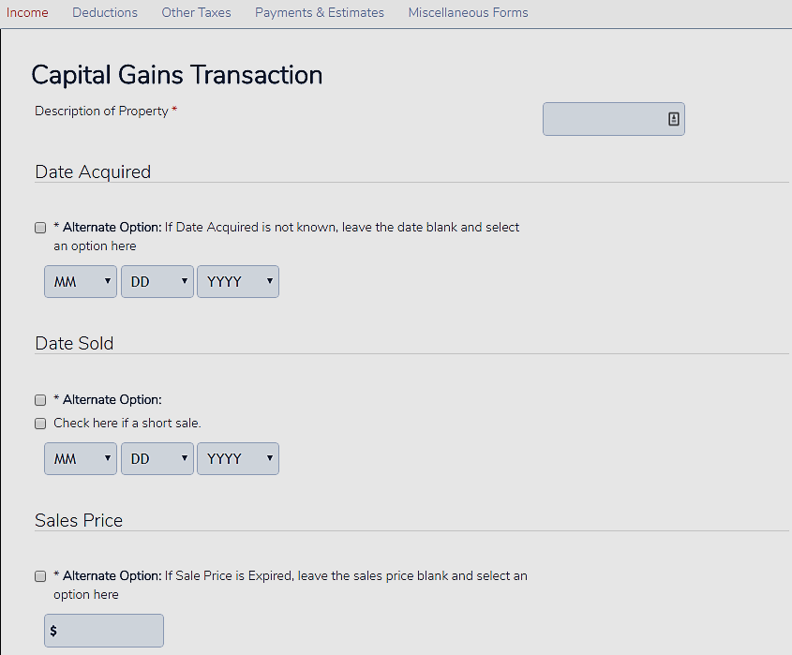
TaxSlayer – Input Top of Page
Click Alternate Option to override MMDDYYYY
Click Alternate Option to override MMDDYYYY
Page is continued on next slide

Slide 66
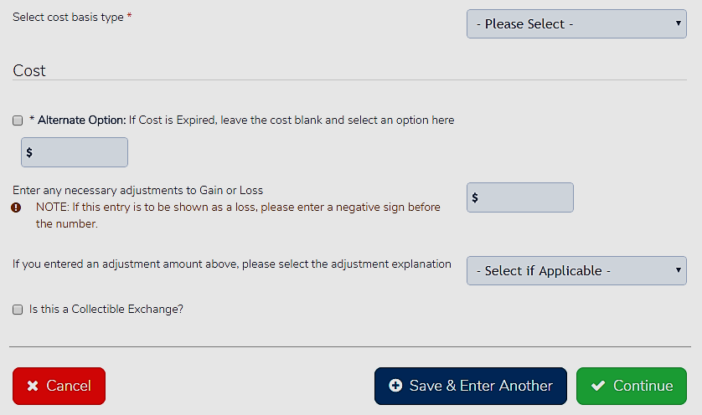
TaxSlayer – Input Bottom of Page
Continued from Top of Page:

Slide 67
Summarizing Multiple Brokerage Transactions
Open Pub 4012 Page D-38:
For each brokerage statement divide the transactions into four categories:
  Short term transactions with basis reported to
  the IRS - categorized as “Box A”
  Short term transactions with basis not reported to the IRS - categorized as “Box B”
  Long term transactions with basis reported to
  the IRS - categorized as “Box D”
  Long term transactions with basis not reported to
  the IRS - categorized as “Box E”

Slide 68
Summarizing Multiple Brokerage Transactions - Continued
For codes A and D with no adjustments, enter summarized totals directly on TaxSlayer Capital Gains/Losses Input Sheet.
For codes B, C, E and F (and A or D that have “taxpayer” adjustments), input summarized totals directly on TaxSlayer Capital Gains Transaction sheet.
  Follow site procedures if or when to send details to IRS.
Notes:
Form 8949 detail should flow properly to the state return, will have sufficient information for the reviewer, prints the summary data for the taxpayer copy of the return, and provides the information needed for the IRS according to 8949 instructions

Slide 69
Adjustment Codes in TaxSlayer
Refer to Publication 4012, D-39 & D-40
Notes:
See Publication 4012, D-39 & D-40

Slide 70
Noncovered Transaction Quiz
For noncovered transactions the broker is not required to report cost basis to the IRS?
Yes

Slide 71
Noncovered Transaction Quiz
Classified codes B and E are noncovered transactions on
Form 8949?
Yes

Slide 72
Noncovered Transaction Quiz
IRS allows taxpayers to summarize transactions for Codes B and E?
Yes, but Tax-Aide Counselors must follow site procedures if copy/send the Broker Statement and/or Form 8453

Slide 73
Noncovered Transaction Quiz
If a Code E transaction with the cost basis is shown on a broker statement, was the cost basis reported the IRS?
No

Slide 74

Reporting Capital Gain & Losses
With enhanced reporting by payers on 1099-B, very few adjustments needed

Slide 75
Capital Loss Carryovers
For TY2016, review 2015 tax return for the schedule computing capital loss carryover available to 2016
  If no loss carryover schedule but 1040 line 13 is exactly -3,000, will need to calculate
  TaxSlayer will carry forward available capital loss carryovers for returning taxpayers next year
Notes:
Emphasize
Double check your state return
Software may not carry forward the state capital loss carryover

Slide 76
Computing Loss Carryovers
Confirm capital loss was claimed in 2015 on Form 1040 Line 13

Slide 77
Computing Loss Carryovers
Confirm that benefit was received
  If 2015 Form 1040 Line 41 is positive
    Benefit was fully received
  The available loss carryover to 2016 will reflect that $3,000 ($1,500 MFS) was used in 2015
Notes:
Line 41 is taxable income BEFORE the personal exemptions deduction

Slide 78
Computing Loss Carryovers
If 2015 Line 41 is negative by $3,000 ($1,500 MFS) or more – no benefit
None of the loss was used
Notes:
Clarify
Now we know that there is a loss carryover
We also know whether to
Reduce the carryover by the full amount
Or to reduce the carryover by the amount that gave benefit

Slide 79
Computing Loss Carryovers
If 2015 Line 41 is negative by less than $3,000 ($1,500 MFS)
  Some of the loss was used
  Here $893 was used ($3,000 – $2,107)
Notes:
Clarify
Now we know that there is a loss carryover
We also know whether to
Reduce the carryover by the full amount
Or to reduce the carryover by the amount that gave benefit

Slide 80
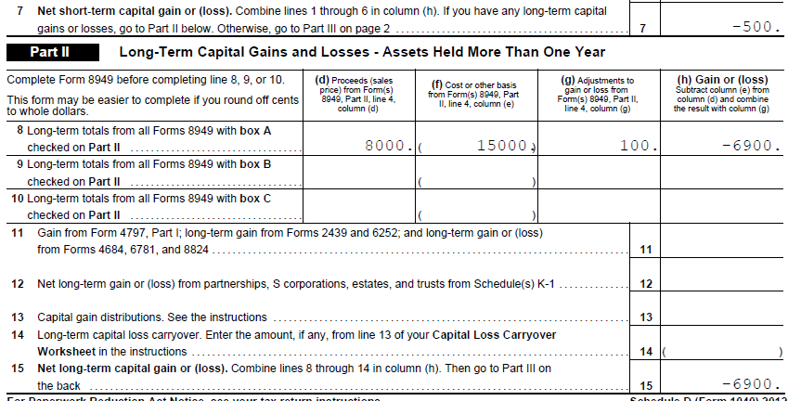
Computing Loss Carryovers
Look at 2015 Sch D Lines 7 and 15
Example here $500 and $6,900

Slide 81
Computing Loss Carryovers
If both Lines 7 and 15 are losses
  There are two possible carryovers
If one is a gain and the other a loss
  There can be only one carryover
  Short or long based on which was the loss

Slide 82
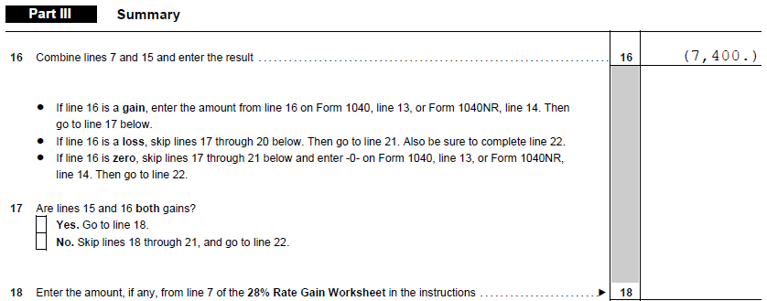
Computing Loss Carryovers
Confirm with Sch D p. 2 for net loss
Yes: 500 + 6,900 = 7,400

Slide 83
Computing Loss Carryovers
Use short term losses first
Use long term losses last
Used only if there is tax benefit (before exemptions) from deducting the loss
Notes:
Tax benefit is determined by looking at Line 41 (not 43) of Form 1040. If this is negative, some of the loss carryover is not needed and will not be used up. The unneeded portion will carryover to the next year even though it shows on this year’s return.

Slide 84
Computing Loss Carryovers
Assume full benefit received of $3,000 loss in 2015
  Use short-term loss first
    $500 is fully used
  Use long-term loss next
    $3,000 total used, less $500 used from short-term loss leaves $2,500 to use from long-term loss

Slide 85
Computing Loss Carryovers
Leaves
  -0- short-term loss carryover
    ($500 less $500 used)
  $4,400 long-term loss carryover
    ($6,900 less $2,500 used)

Slide 86
Loss Carryovers
Use taxpayers prior return
Form 1040 Schedule D
Input loss carryover(s) in
TaxSlayer Other Capital Gains Data input sheet
May need to input state loss carryover

Slide 87
What is a Wash Sale
Sale of securities at a loss -AND-purchase of “same” securities within 30 days of sale date (before or after)
Result is that loss (in part or in whole) is disallowed... until later
In scope only if reported on brokerage or mutual fund statement
Notes:
Brokerage or mutual fund will do all of the accounting
If not on a brokerage statement, remains OOS

Slide 88

Wash Sale
What happens to disallowed loss in Wash Sale situation?
  Basis of new shares is increased by amount of prior disallowed loss
Brokers/mutual funds do the accounting!
Notes:
Brokerage or mutual fund will do all of the accounting if they report the wash sale to the taxpayer, whether or not they report it to the IRS

Slide 89
Wash Sale Example #1
6/1/16 sell 300 shares of ABC for loss of $200
6/15/16 buy 300 shares of ABC for $2,400
None of loss allowed in 2016
Basis of 300 new shares is $2,600
    ($2,400 cost + $200 disallowed loss)
Notes:
Emphasize:
Because only 50 shares were repurchased, the loss related to 50 shares is disallowed
The loss related to the other 150 shares is allowed

Slide 90
Wash Sale Example #1
$200 loss not allowed
Broker statement will provide amount of adjustment needed
Notes:
Wash sales reported on 1099-B are in scope
All other wash sale situations are out of scope
In no event should a Counselor compute a wash sale loss for a taxpayer

Slide 91
Wash Sale Example #2
3/1/16 sell 200 shares of XYZ for loss of $400
3/15/16 buy 50 shares of XYZ at cost of $2,500
Loss not allowed in 2016: $100
    (50 shs ÷ 200 shs x $400)
Basis of 50 new shares is $2,600
    ($2,500 cost + $100 disallowed loss)
Loss allowed in 2016: $300
    (150 shs ÷ 200 shs x $400)
Notes:
Emphasize:
Because only 50 shares were repurchased, the loss related to 50 shares is disallowed
The loss related to the other 150 shares is allowed

Slide 92
Wash Sale Example #2
Of $400 loss, $100 not allowed and $300 allowed
Broker statement will provide amount of adjustment needed

Slide 93
Special Situation
Worthless stock or bond loss
  Stock must be totally worthless in 2016
    (1¢ is still value and cannot write off)
  “Deemed” sold at end of year
  TaxSlayer > Under Date Sold:
    Click “Alternate Option: and select applicable choice

Slide 94

Input is Done?
TaxSlayer will
  Determine whether long/short term
  Calculate gain/loss
  Carry data to Form 8949 and
  Schedule D
Notes:
94

Slide 95
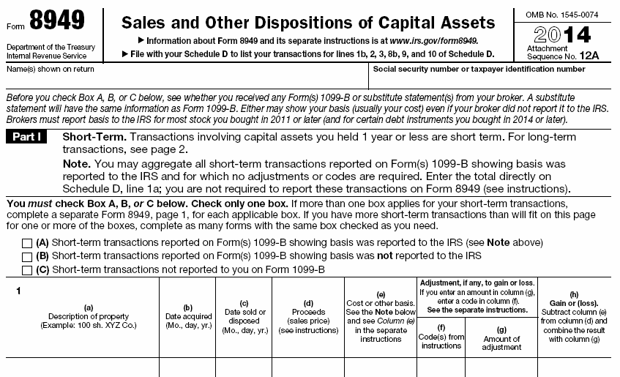
2016
Form automatically populated by TaxSlayer input and transferred to Schedule D

Slide 96
Tax Forms
May have up to six forms 8949 - one for each 1099 code
Only one Schedule D
Notes:
Usually, no more than 4 flavors of 8949 as very few “C” transactions are in scope; really, only sale of residence

Slide 97
Tax Calculation
TaxSlayer calculates tax liability
  Using capital gain rates
  If there is amount eligible for capital gains tax:
    Net long-term gain
    Qualified dividends
  Qualified Dividends and Capital Gain Tax Worksheet – Line 44
    (find in print PDF)
Notes:
97

Slide 98
Tax Calculation
Note:
Qualified dividends are taxed as long-term capital gains
  But are not offset by capital losses

Slide 99
Calculations
TaxSlayer calculates capital loss carryover from 2016 to 2017
Worksheet is included for next year’s preparer if there is a loss carryover
Notes:
99
Emphasize
Reviewers should make sure carryover sheet is printed for the taxpayer’s copy

Slide 100
Sale of Principal Residence (“Main Home”)
Generally not a taxable event if:
  Residence was main home
  Taxpayer satisfies ownership and use tests
  Gain less than $250,000 ($500,000 MFJ)
  Taxpayer did not receive
  Form 1099-S

Slide 101
Interview – Sale of Principal Residence (“Main Home”)
Ever rented out or claimed home office?
How long owned?
Used as main residence? How long?
Does taxpayer have net sales price?
Does taxpayer have cost information?
  Including improvements to the property?
Notes:
Emphasize
If home was ever rented out or used in business (except simplified home office deduction), out of scope
Taxpayer needs to determine the net sales price
Counselors should not determine the sales price from escrow statements
Taxpayer needs to determine total cost of their home, including improvements
If the taxpayer does not have this information, they will need to compile it and return another day
Taxpayer can refer to IRS Pub 523 Selling Your Home for more information

Slide 102
Main Home Basis Quiz
Can this be added to basis?
Kitchen remodel?
Fixing a leaky pipe?
New roof?
2nd new roof?
Yes
No
Yes
Remove cost of 1st, add 2nd

Slide 103
Sale of Main Home
Pub 4491 P 11-11
Report on tax return if
  Any part of gain is taxable
  Any time Form 1099-S is received

Slide 104
What is a Main Home
Where taxpayer lives most of the time
Can be houseboat, mobile home, condo or co-op
Must have cooking, sleeping and bathroom facilities

Slide 105
Main Home
If more than one home, main home is one taxpayer lives in most of the time
Taxpayer cannot simply “choose”

Slide 106

Sale of Main Home
Exclusion of gain
  Up to $250,000 ($500,000 MFJ)
  Must meet both tests:
    Ownership
    Use

Slide 107
Sale of Main Home
During 5 years ending with date of sale:
  Ownership test:
    Owned the home for at least two years
  Use test:
    Lived in home as main home for at least two years
The two-year periods do not have to be continuous nor overlapping
Notes:
Two years defined as: 24 full months or 730 days (365 x 2)
Ownership and use tests can be met during different two-year periods
However, a taxpayer must meet both tests during the five-year period ending on the date of the sale

Slide 108
Sale of Main Home
Cannot claim another exclusion within two years of prior exclusion

Slide 109
Sale of Main Home –
Married Taxpayers
Married taxpayers’ $500,000 exclusion
  Must file joint return
  Either spouse meets ownership test
  Both individuals meet use test
  Neither one excluded gain in two years before sale of current home
Otherwise, use test to see if one spouse qualifies for $250,000 exclusion
Notes:
If not eligible for maximum exclusion, the most they can claim is the total of the maximum exclusions each would qualify for if not married and the amounts were figured separately
For this purpose, each spouse is treated as owning the property during the period that either spouse owned the property
This calculation is out of scope

Slide 110
Sale of Main Home –
Surviving Spouse
Unmarried surviving spouse
Can claim exclusion up to $500,000
Sale must occur no later than two years after date of spouse’s death
AND
The Married Taxpayer conditions were met immediately before the death
Notes:
Clarify
This is different than the qualifying widow(er) with child status

Slide 111
Sale of Main Home –
Surviving Spouse
Basis in surviving spouse’s hands (assuming survivor now owns all)
Depends on whether separate property or community property
Depends on how property was titled
Notes:
Depending on your state:
Separate property
Surviving spouse gets a stepped up basis for decedent’s half
E.g. cost $25,000
Fair market value (FMV) at date of death (DoD) $80,000
Basis to survivor ½ of $25,000 cost = $12,500 plus ½ of FMV at DoD $40,000 = $52,500
Community property
Property must have been titled as “community property”
Basis of entire property is stepped up to FMV at Dod
In same example, survivor’s basis would be $80,000

Slide 112
Sale of Main Home
Special rules for military, intelligence and Peace Corp personnel
  Suspension of 5-yr rule
  See Pub 4491 Page 127

Slide 113
Sale of Main Home
Special rule
  Home is considered used as home during short-term absences (even if rented out)

Slide 114
Sale of Main Home
Special rule if tests not met due to
  Change of employment
  Unforeseen circumstances (e.g. health)
Reduced exclusion possible
  Out of scope
Notes:
Possible reduced exclusion? See Pub 523 page 6 Figuring Gain or Loss and go through the How to Figure Your Gain or Loss Worksheet to determine if any basis adjustments might be necessary.

Slide 115
Sale of Main Home
Figuring gain or loss
  Amount realized (on sale)
  Determining (cost) basis
  Maximum exclusion
Taxpayer needs to provide sale price and basis information
Remember inherited property basis rules

Slide 116
Sale of Home Quiz
John purchased a condo in 2004 and lived in it until 2016 (when he put it up for sale)
Jane was divorced in 2005 and has lived in her home since then until
John and Jane married in 2015 and began living together in Jane’s home
John sold his condo in 2016 for a $300,000 gain
Does John qualify to exclude the gain if MFJ?

Slide 117
Sale of Home Quiz Answer
Does John qualify to exclude the gain if MFJ?
  Ownership test – yes, owned since 2004
  Use test – yes for John; but was not Jane’s main home for 2 years during 5 years preceding sale
  So can exclude up to $250,000 only

Slide 118

Sale of Main Home Input
In TaxSlayer open:
    “Sale of Home Worksheet”
  Taxpayer answers the
    “Basic Information about Your Home”
  If necessary taxpayer answers the
    “Adjustments to the Sale Worksheet”
TaxSlayer adds to “Print PDF” (if necessary):
  Schedule D Sale of Home Worksheet
  Form 8949 (Box F checked with adjustment code H)
Notes:
If total adjustment is more than the maximum “H” adjustment, move selling costs to increase original basis.

Slide 119
Sale of Personal Residence
What if not “main home”
  No exclusion
  Any gain is taxable
  Any loss is not deductible
Residences that have NEVER been rented out or used in a business are in scope

Slide 120

Quality Review:
Capital Gain or Loss
Verify all transactions entered correctly
  Use TaxSlayer pdf Print File > Form 8949 to verify broker statement transactions
  Do total short term/long term gains and losses agree with statements or taxpayer records
For Summarizing broker transactions:
  Follow procedures for summarizing multiple transactions
  Check 8949 Codes B & E
  Follow site procedures for filing Form 8453 with the return

Slide 121
Quality Review: Capital Gain or Loss
Verify that total proceeds reported on Sch D equal amounts reported on 1099-B
Did capital gain distributions (if any) come forward to Sch D properly
Verify any K-1 capital gains or losses (separate lesson on K-1 forms)

Slide 122
Quality Review: Capital Gain or Loss
Verify any capital loss carryovers
Confirm all tests met if claiming exclusion of gain from sale of main home
Confirm no losses are claimed on personal assets

Slide 123

Taxpayer Summary Capital
Gain or Loss
Discuss amount of any capital loss carryover
Remind taxpayer they will need to bring this year’s paper copy of the their tax filing next year
Notes:
123

Slide 124
Capital Gain (Loss)
Questions…
Comments…

Slide 125
Additional Help At IRS.gov
FAQs - Capital Gains, Losses/Sale of Home
FAQs - Mutual Funds (Costs, Distributions, etc.)
FAQs - Stocks (Options, Splits, Traders)
Tax Trails - Capital Gains and Losses
Tax Trails - Ten Important Facts About Capital Gains and Losses
Tax Tip - Sale of Residence - Real Estate Tax Tips
Publication 523 – Selling Your Home

